Slide 1
Cause of Death Data Analysis
Submitted By- Rakesh Shinde

Slide 2
Introduction
A straightforward way to assess the health status of a population is to focus on mortality – or concepts like child mortality or life expectancy, which are based on mortality estimates. A focus on mortality, however, does not take into account that the burden of diseases is not only that they kill people, but that they cause suffering to people who live with them. Assessing health outcomes by both mortality and morbidity (the prevalent diseases) provides a more encompassing view on health outcomes. This is the topic of this entry. The sum of mortality and morbidity is referred to as the ‘burden of disease’ and can be measured by a metric called ‘Disability Adjusted Life Years‘(DALYs). DALYs are measuring lost health and are a standardized metric that allow for direct comparisons of disease burdens of different diseases across countries, between different populations, and over time. Conceptually, one DALY is the equivalent of losing one year in good health because of either premature death or disease or disability. One DALY represents one lost year of healthy life. The first ‘Global Burden of Disease’ (GBD) was GBD 1990 and the DALY metric was prominently featured in the World Bank’s 1993 World Development Report. Today it is published by both the researchers at the Institute of Health Metrics and Evaluation (IHME) and the ‘Disease Burden Unit’ at the World Health Organization (WHO), which was created in 1998. The IHME continues the work that was started in the early 1990s and publishes the Global Burden of Disease study.

Slide 3
Understanding the Dataset
01. Country/Territory - Name of the Country/Territory
02. Code - Country/Territory Code
03. Year - Year of the Incident
04. Meningitis - No. of People died from Meningitis
05. Alzheimer's Disease and Other Dementias - No. of People died from Alzheimer's Disease and Other Dementias
06. Parkinson's Disease - No. of People died from Parkinson's Disease
07. Nutritional Deficiencies - No. of People died from Nutritional Deficiencies
08. Malaria - No. of People died from Malaria
09. Drowning - No. of People died from Drowning
10. Interpersonal Violence - No. of People died from Interpersonal Violence

Slide 4
Understanding the Dataset
11. Maternal Disorders - No. of People died from Maternal Disorders
12. Drug Use Disorders - No. of People died from Drug Use Disorders
13. Tuberculosis - No. of People died from Tuberculosis
14. Cardiovascular Diseases - No. of People died from Cardiovascular Diseases
15. Lower Respiratory Infections - No. of People died from Lower Respiratory Infections
16. Neonatal Disorders - No. of People died from Neonatal Disorders
17. Alcohol Use Disorders - No. of People died from Alcohol Use Disorders
18. Self-harm - No. of People died from Self-harm
19. Exposure to Forces of Nature - No. of People died from Exposure to Forces of Nature
20. Diarrheal Diseases - No. of People died from Diarrheal Diseases
21. Environmental Heat and Cold Exposure - No. of People died from Environmental Heat and Cold Exposure

Slide 5
Understanding the Dataset
22. Neoplasms - No. of People died from Neoplasms
23. Conflict and Terrorism - No. of People died from Conflict and Terrorism
24. Diabetes Mellitus - No. of People died from Diabetes Mellitus
25. Chronic Kidney Disease - No. of People died from Chronic Kidney Disease
26. Poisonings - No. of People died from Poisoning
27. Protein-Energy Malnutrition - No. of People died from Protein-Energy Malnutrition
28. Chronic Respiratory Diseases - No. of People died from Chronic Respiratory Diseases
29. Cirrhosis and Other Chronic Liver Diseases - No. of People died from Cirrhosis and Other Chronic Liver Diseases
30. Digestive Diseases - No. of People died from Digestive Diseases
31. Fire, Heat, and Hot Substances - No. of People died from Fire or Heat or any Hot Substances
32. Acute Hepatitis - No. of People died from Acute Hepatitis

Slide 6
Filling null values
No null values

Slide 7
Top 10 Death toll in world according to Causes

Slide 8
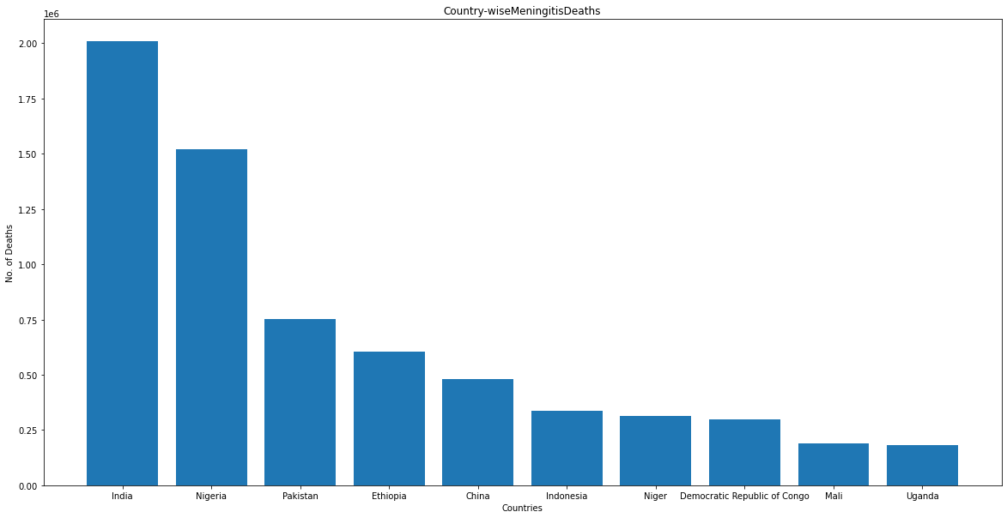
Top 10 Countries with death Counter due to Meningitis

Slide 9
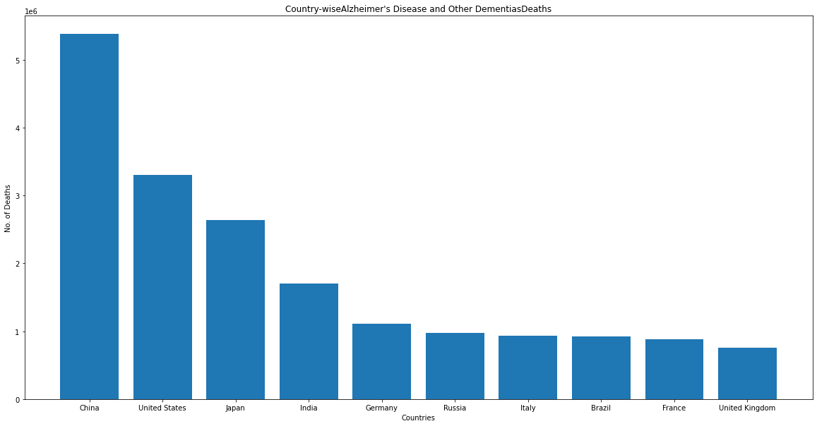
Top 10 Countries with death Counter due to Alzheimer's Disease and Other Dementias

Slide 10
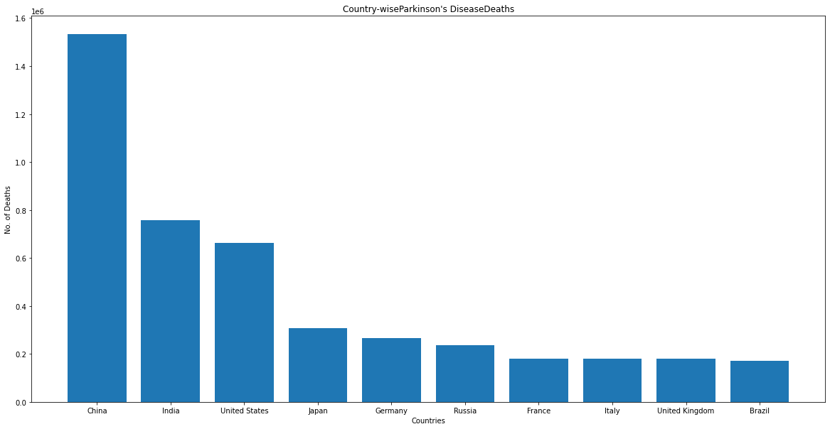
Top 10 Countries with death Counter due to Parkinson's Disease

Slide 11
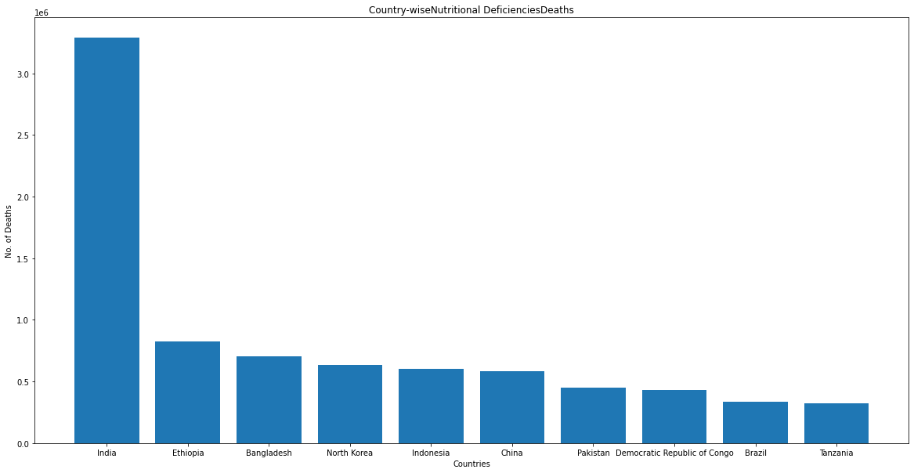
Top 10 Countries with death Counter due to Nutritional Deficiencies

Slide 12
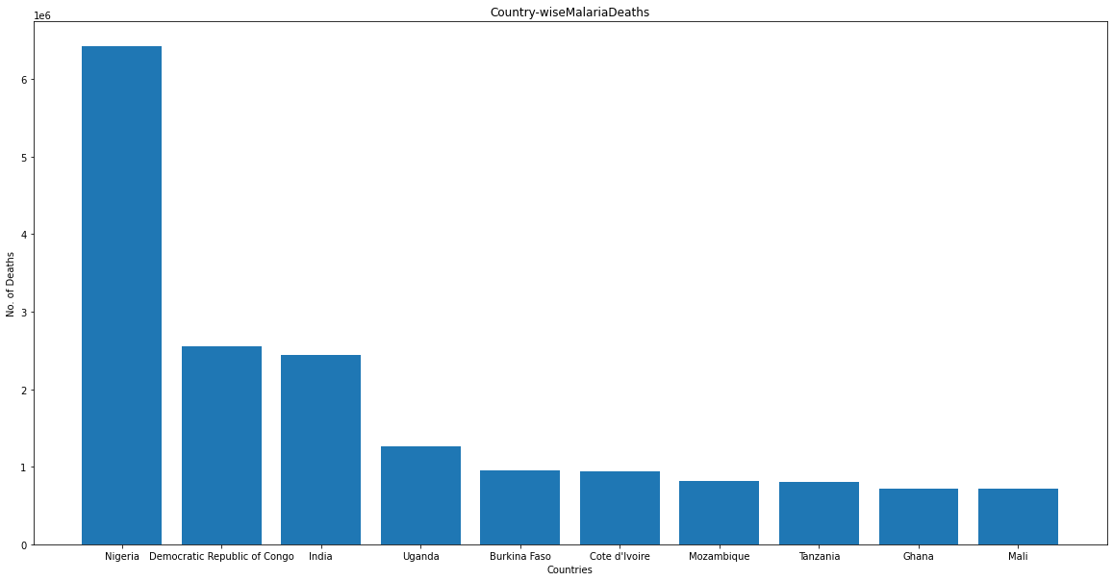
Top 10 Countries with death Counter due to Malaria

Slide 13
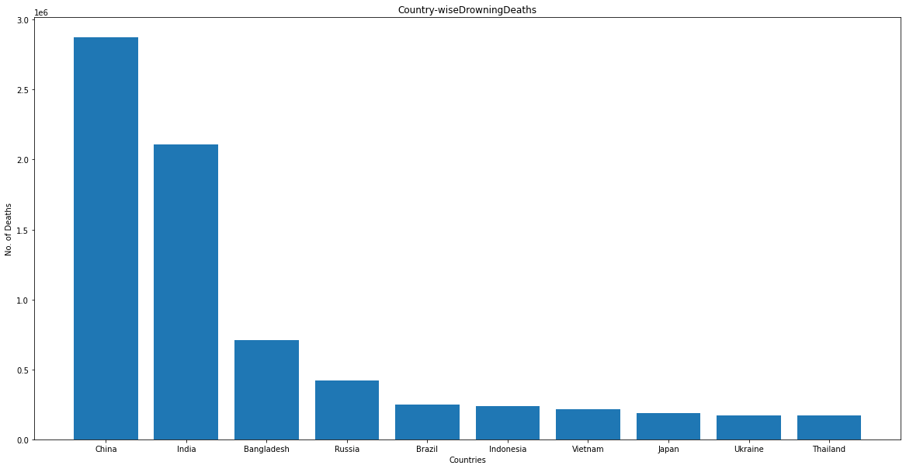
Top 10 Countries with death Counter due to Drowning

Slide 14
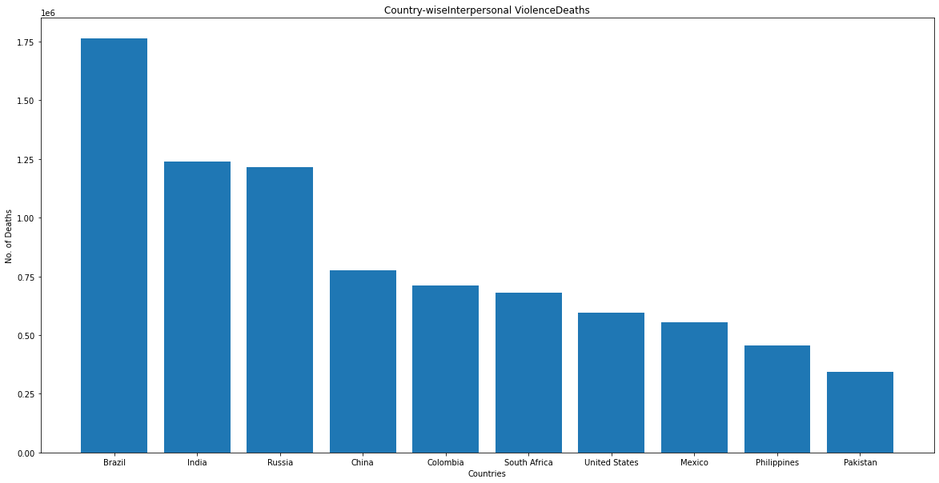
Top 10 Countries with death Counter due to Interpersonal Violence

Slide 15
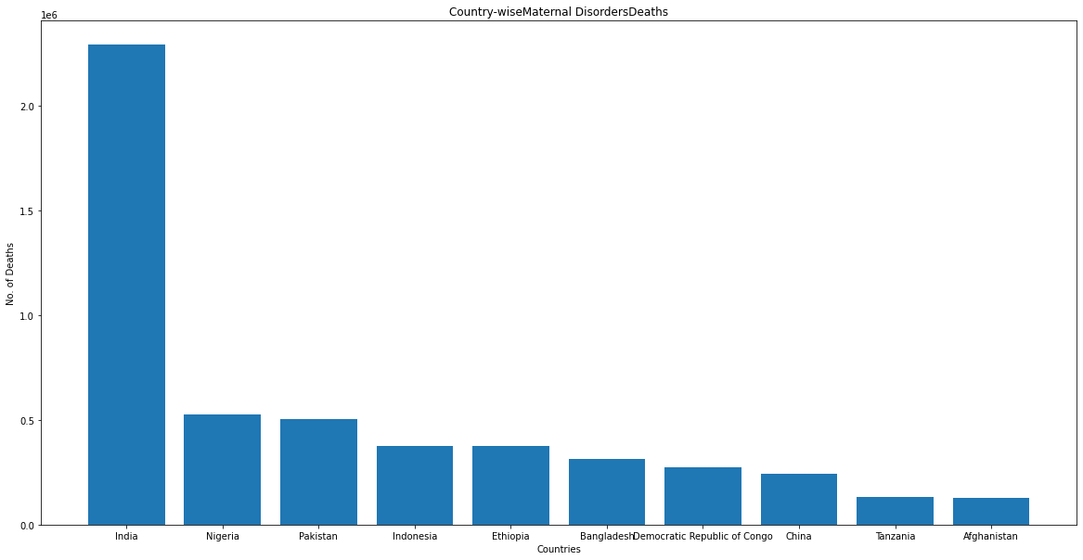
Top 10 Countries with death Counter due to Maternal Disorders

Slide 16
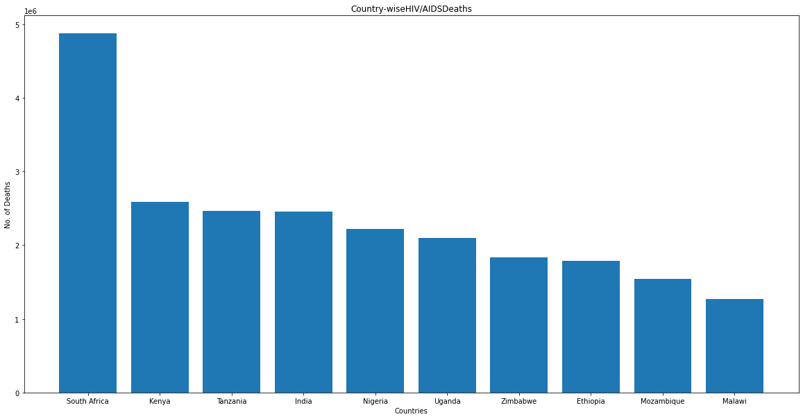
Top 10 Countries with death Counter due to HIV/AIDS

Slide 17
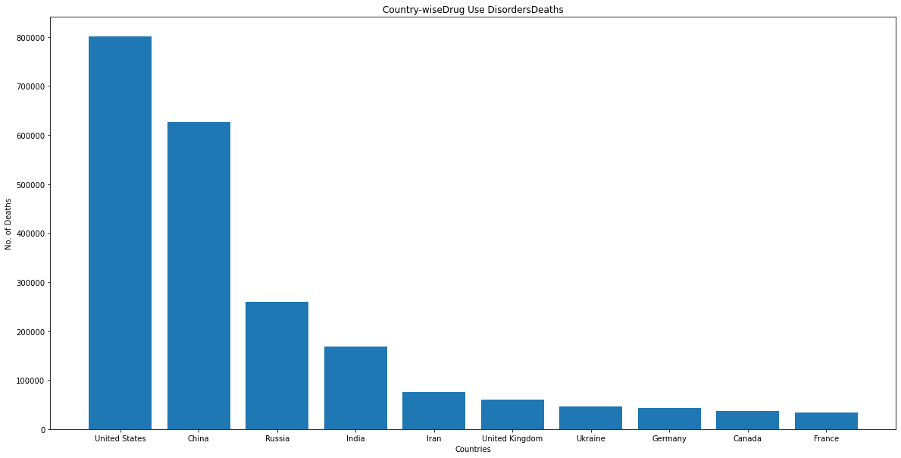
Top 10 Countries with death Counter due to Drug Use Disorders

Slide 18
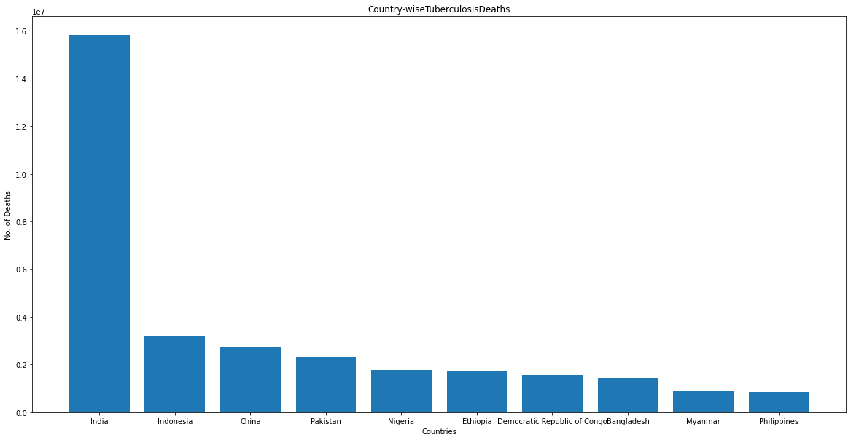
Top 10 Countries with death Counter due to Tuberculosis

Slide 19
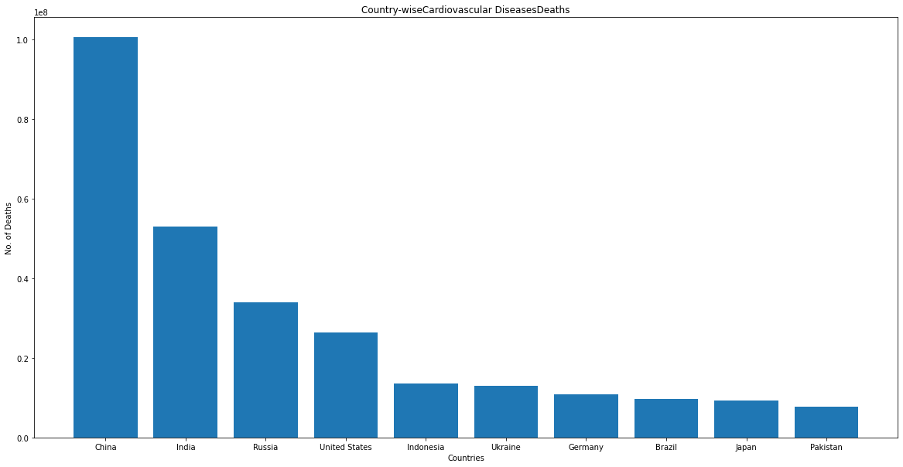
Top 10 Countries with death Counter due to Cardiovascular Diseases

Slide 20
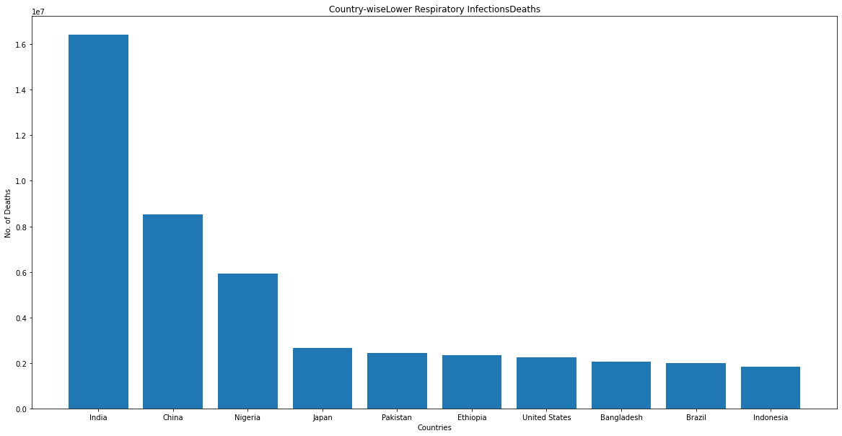
Top 10 Countries with death Counter due to Lower Respiratory Infections

Slide 21
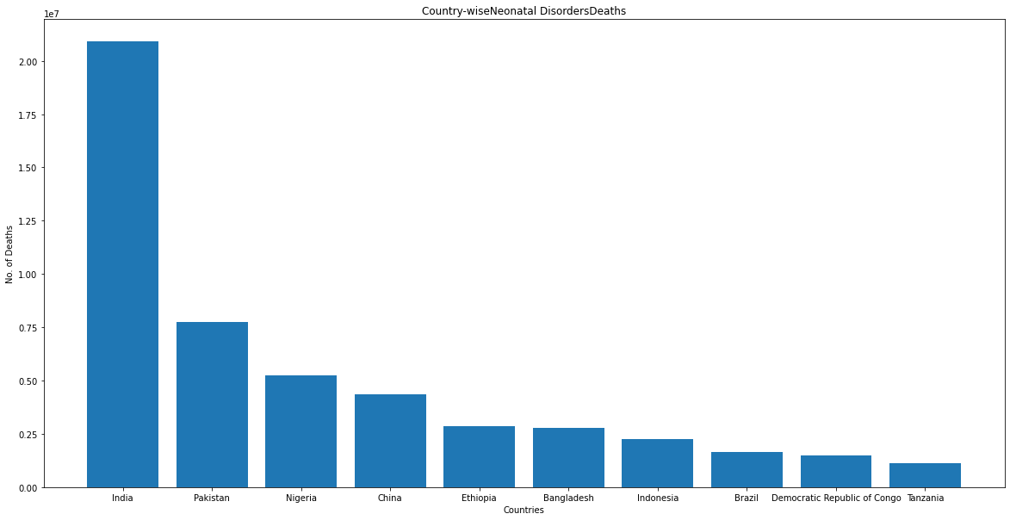
Top 10 Countries with death Counter due to Neonatal Disorders

Slide 22
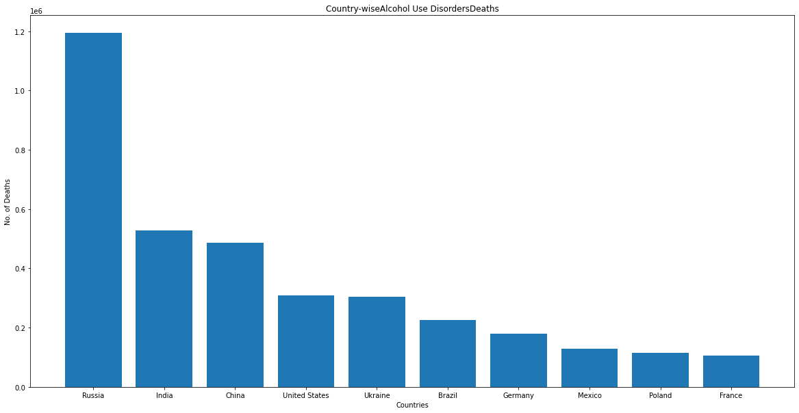
Top 10 Countries with death Counter due to Alcohol Use Disorders

Slide 23
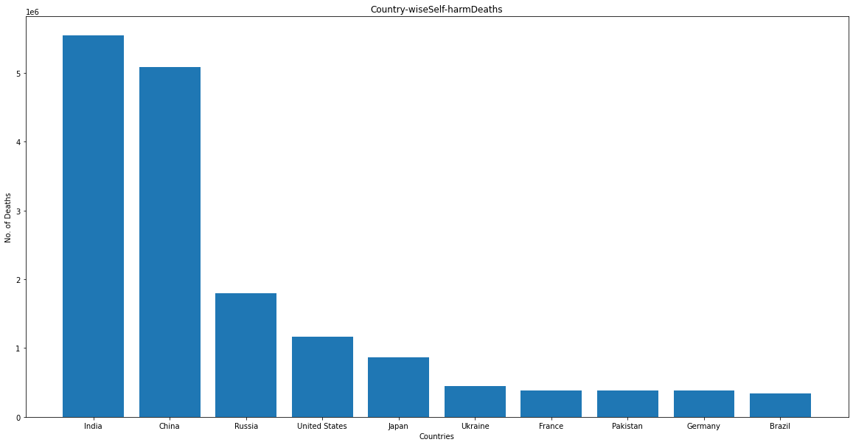
Top 10 Countries with death Counter due to Self-harm

Slide 24
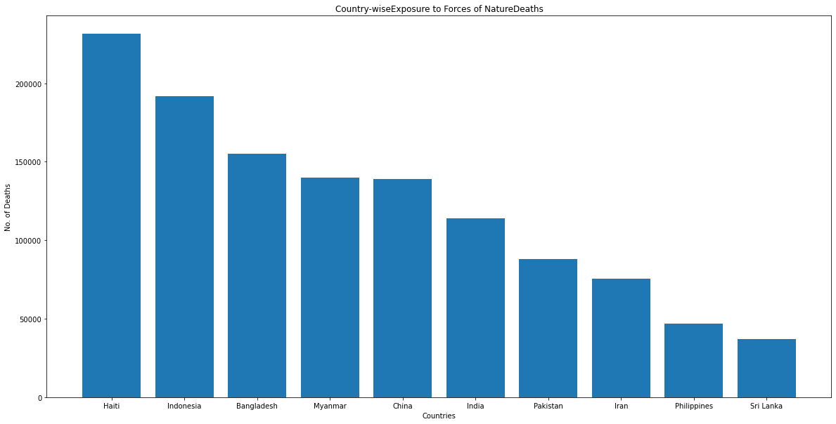
Top 10 Countries with death Counter due to Exposure to Forces of Nature

Slide 25
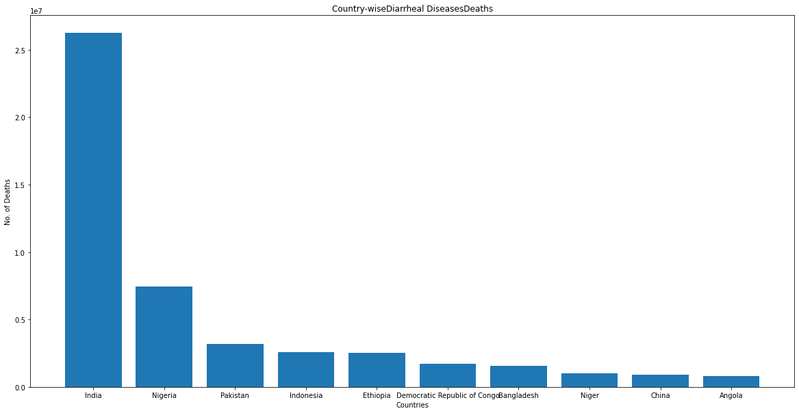
Top 10 Countries with death Counter due to Diarrheal Diseases

Slide 26
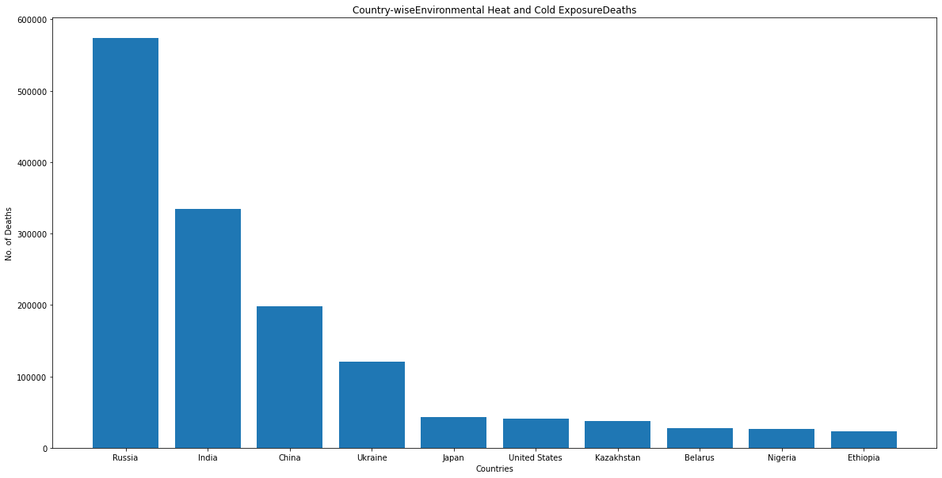
Top 10 Countries with death Counter due to Environmental Heat and Cold Exposure

Slide 27
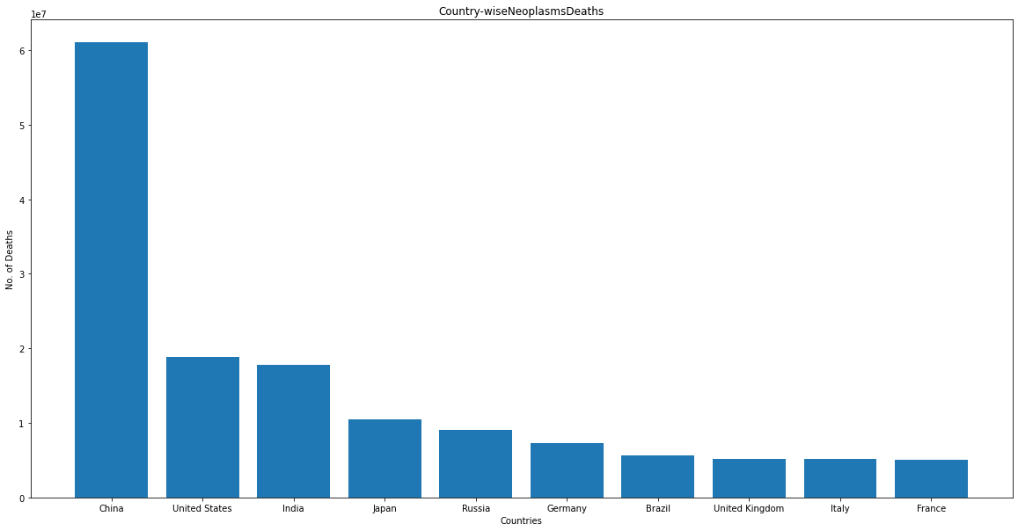
Top 10 Countries with death Counter due to Neoplasms

Slide 28
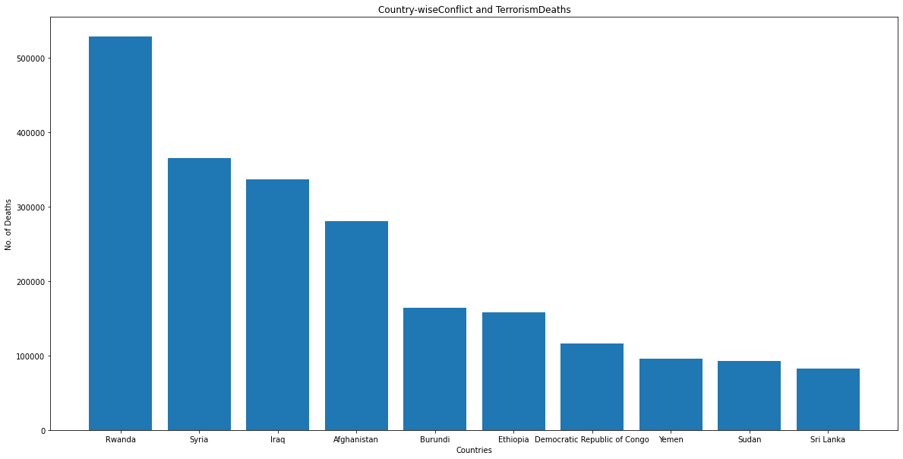
Top 10 Countries with death Counter due to Conflict and Terrorism

Slide 29
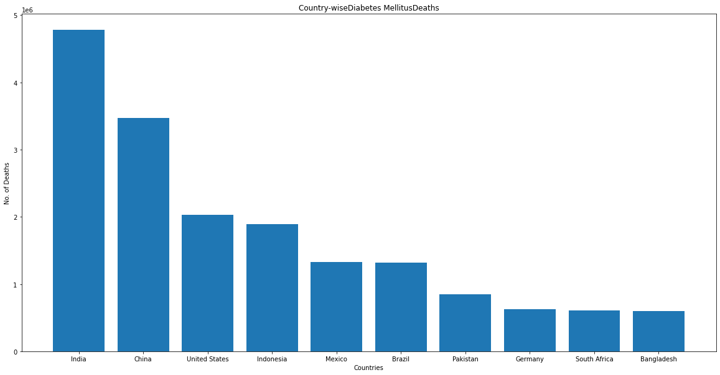
Top 10 Countries with death Counter due to Diabetes Mellitus

Slide 30
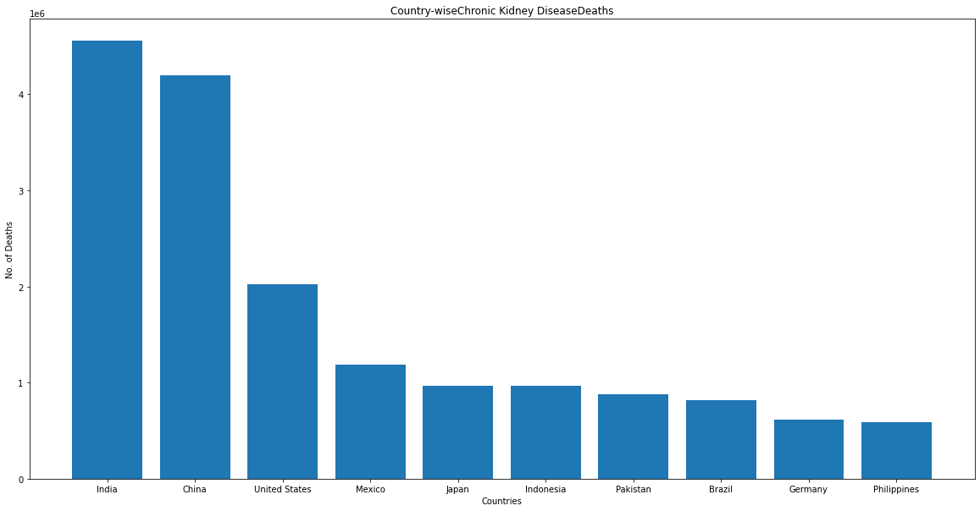
Top 10 Countries with death Counter due to Chronic Kidney Disease

Slide 31
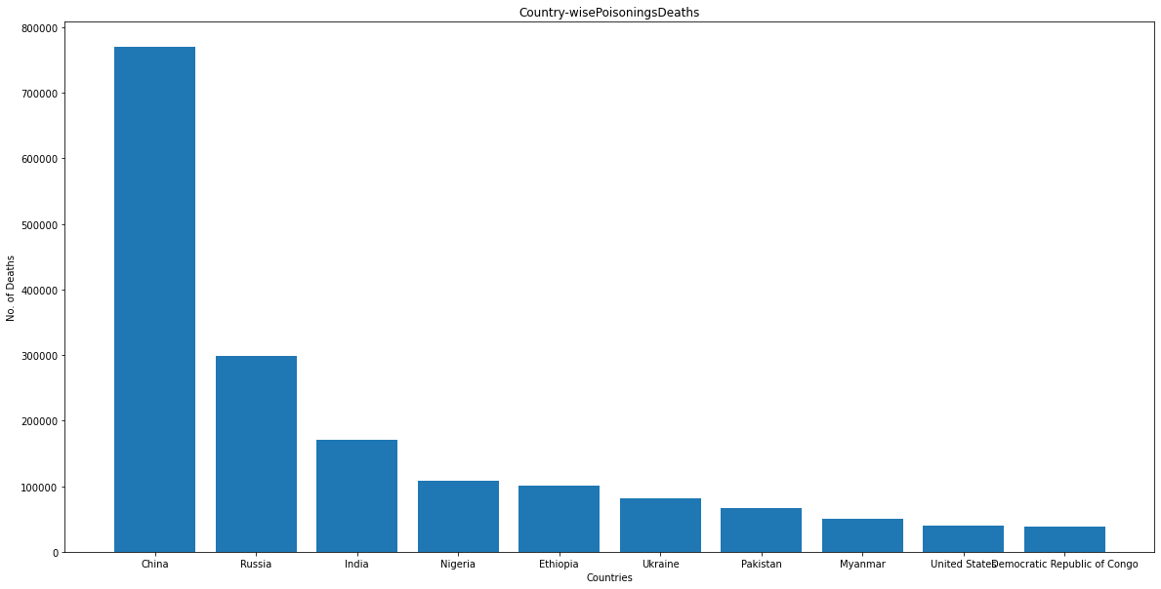
Top 10 Countries with death Counter due to Poisonings

Slide 32
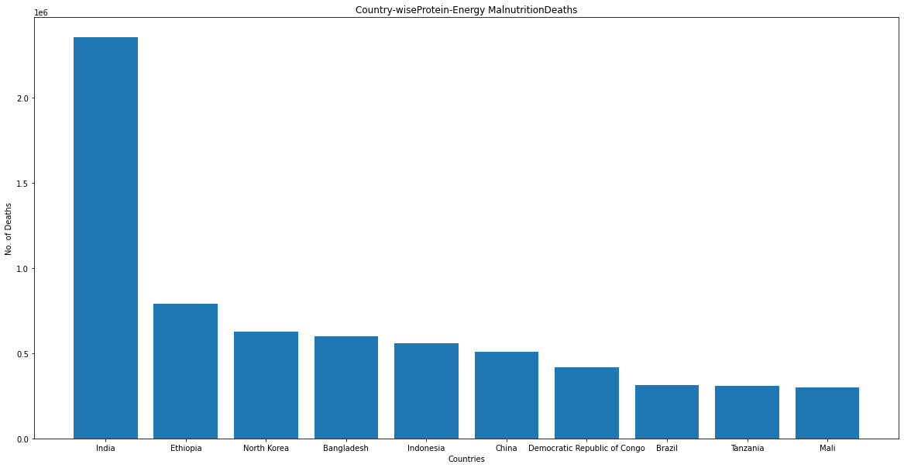
Top 10 Countries with death Counter due to Protein-Energy Malnutrition

Slide 33
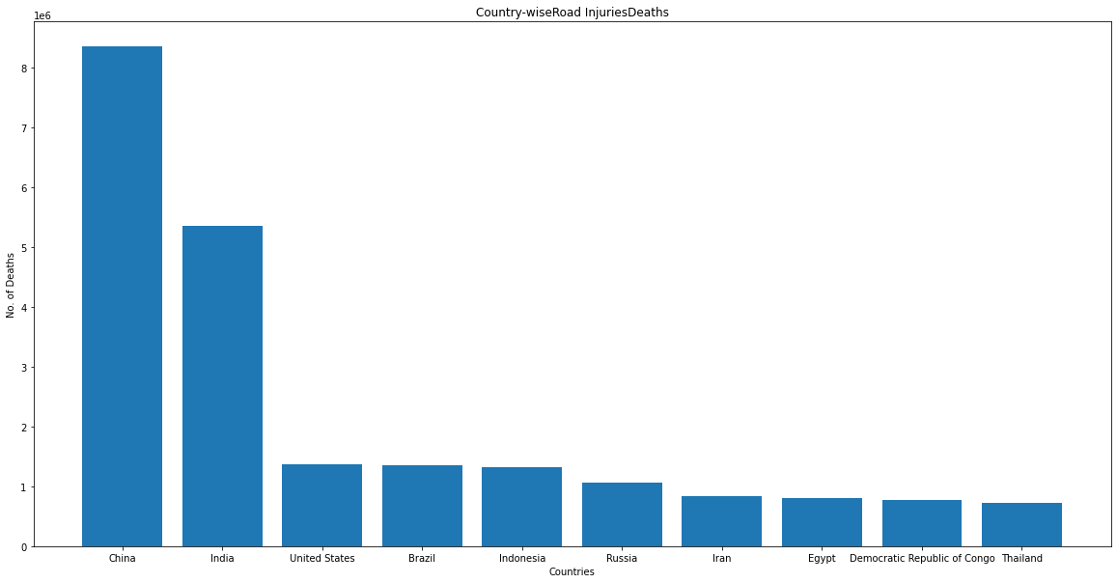
Top 10 Countries with death Counter due to Road Injuries

Slide 34
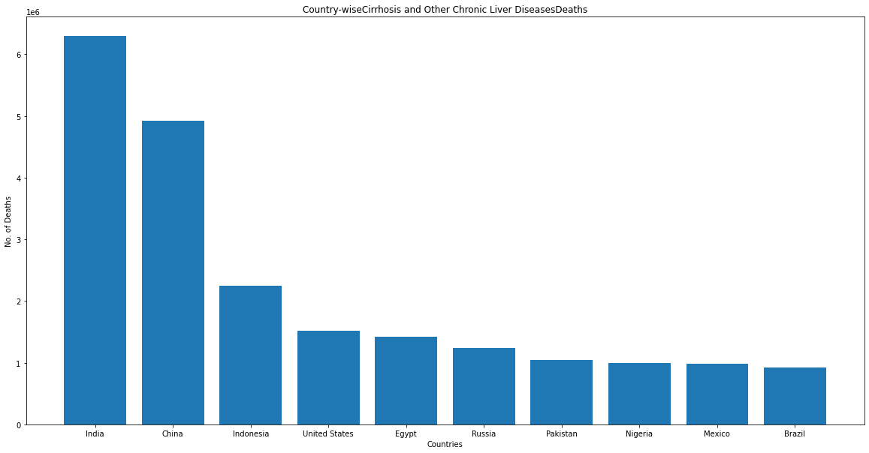
Top 10 Countries with death Counter due to Cirrhosis and Other Chronic Liver Diseases

Slide 35
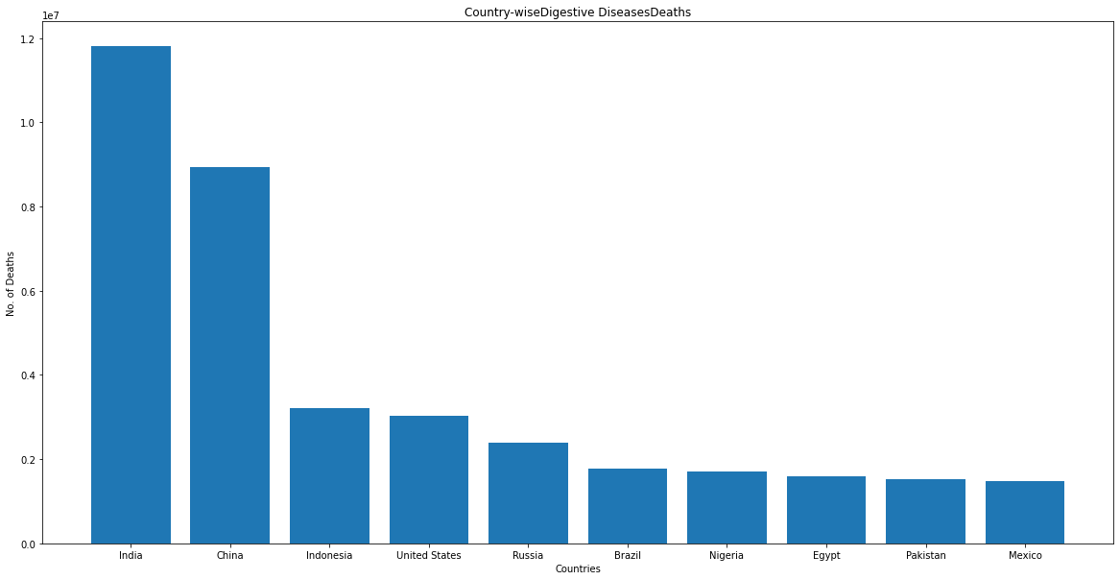
Top 10 Countries with death Counter due to Digestive Diseases

Slide 36
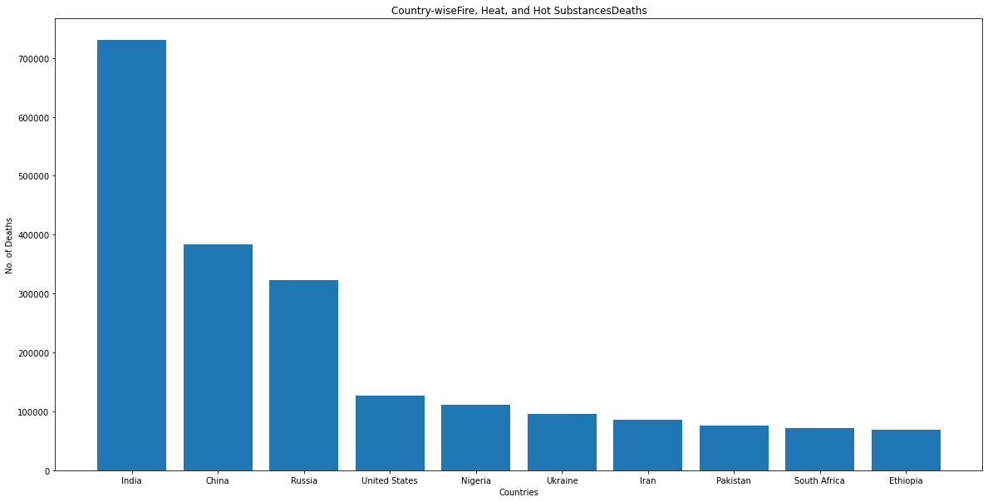
Top 10 Countries with death Counter due to Fire, Heat, and Hot Substances

Slide 37
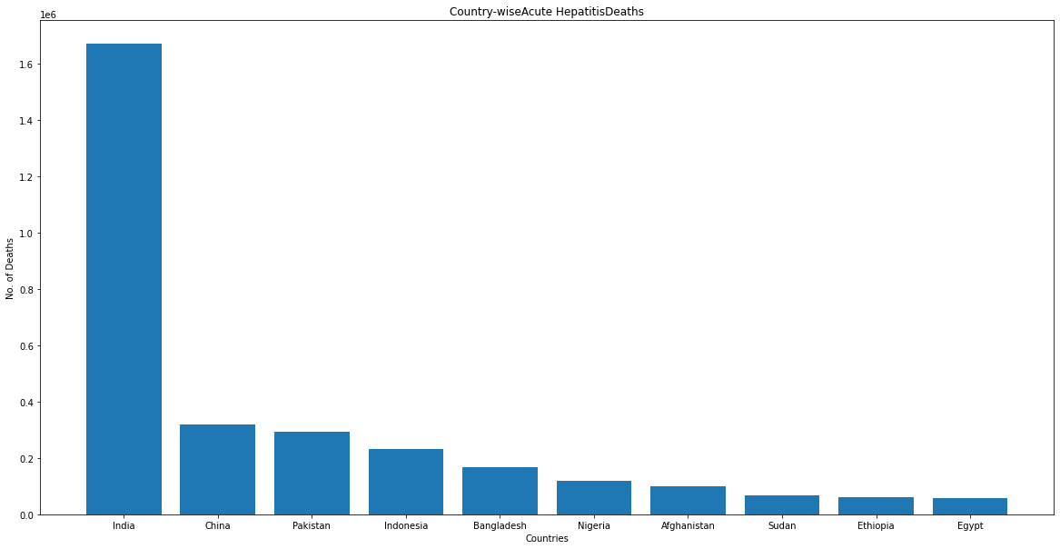
Top 10 Countries with death Counter due to Acute Hepatitis

Slide 38
Findings:
China and India are leading in death counts in millions for maximum no. of diseases followed by USA, Russia.
As we can conclude that these countries are more populated and hence death counts are more
We also can also say that there will be more pressure on the health care system of these countries
There is one notable thing in the death counts from conflict/terrorism is that in Rwanda in these 30 years more than 5 lacs, followed by countries like Syria, Iraq, Afghanistan for terrorism.

Slide 39
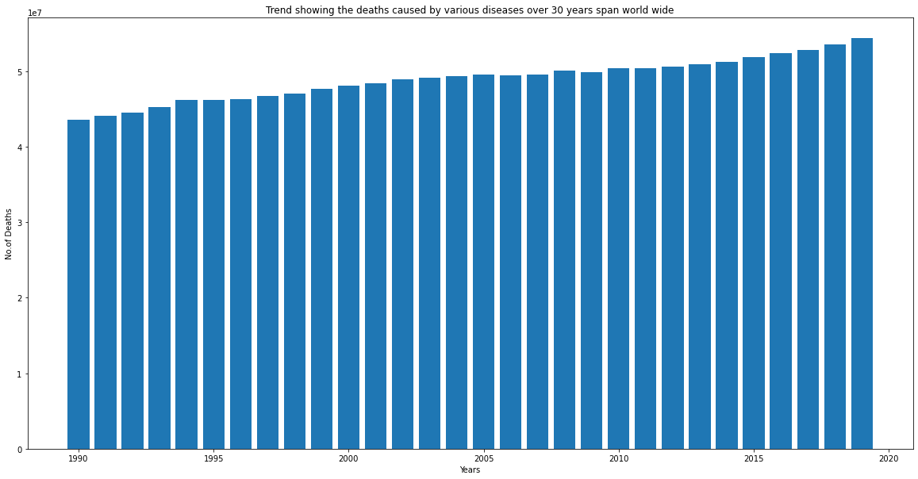
World Death toll from 1990 to 2019 (for 30 years)
Findings:
We can see that the death count is increasing as the year by year proportional to the increase in population count.

Slide 40
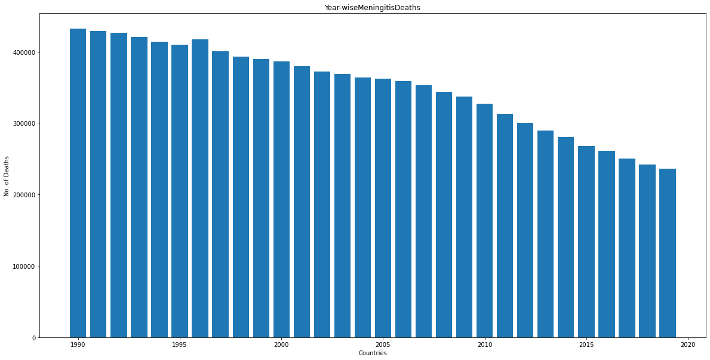
Death Counts over 30 years due to Meningitis

Slide 41
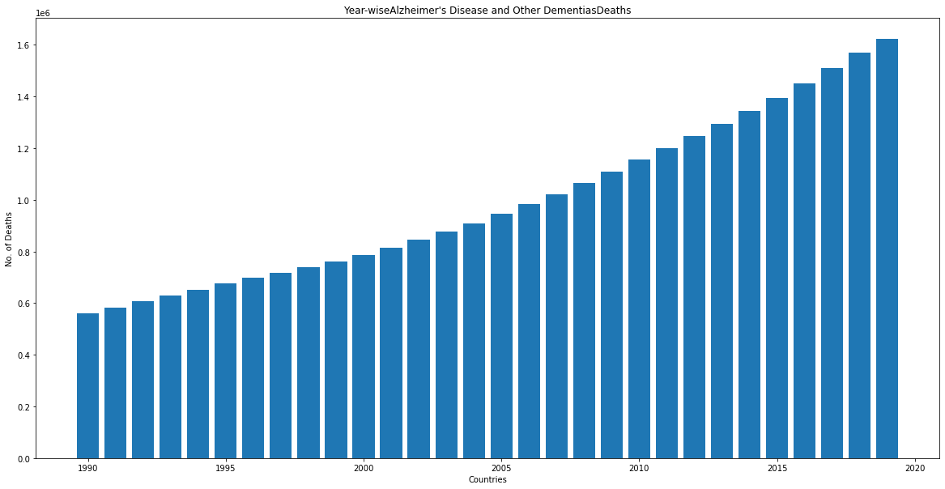
Death Counts over 30 years due to Alzheimer's Disease and Other Dementias

Slide 42
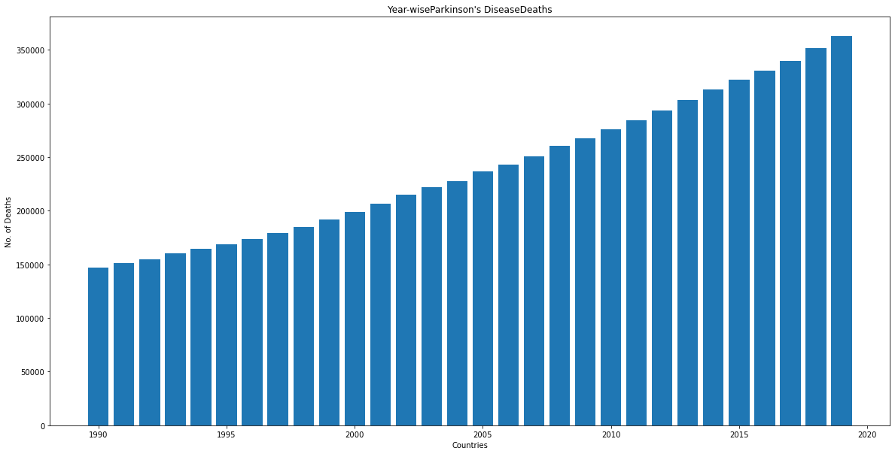
Death Counts over 30 years due to Parkinson's Disease

Slide 43
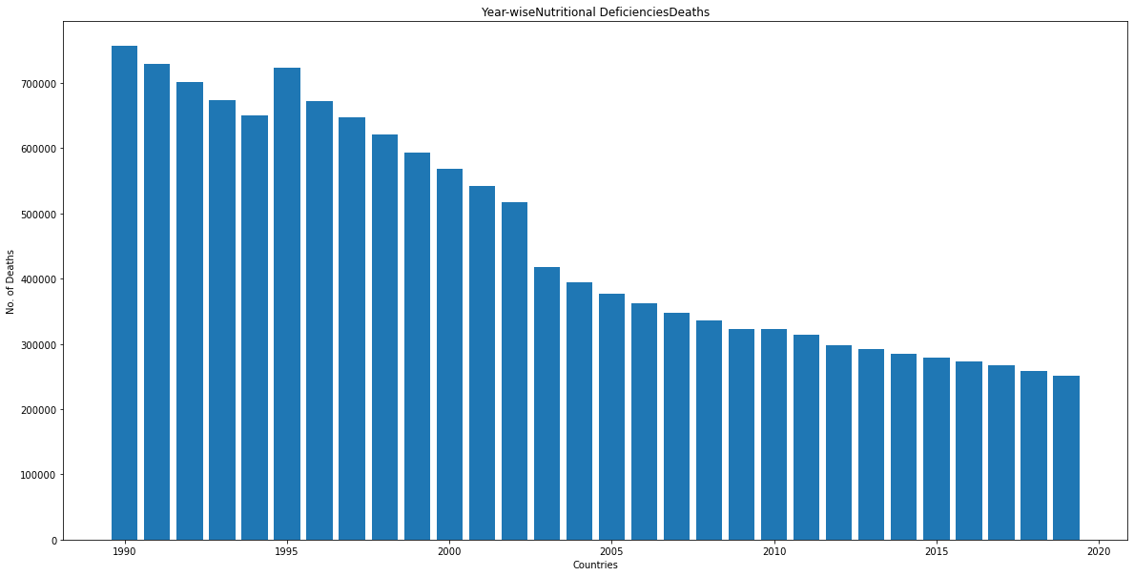
Death Counts over 30 years due to Nutritional Deficiencies

Slide 44
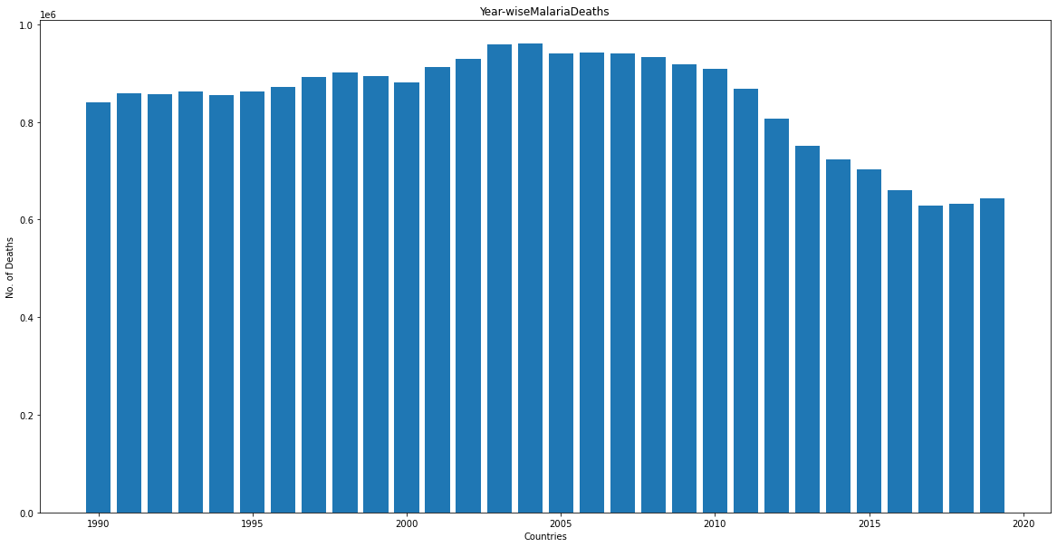
Death Counts over 30 years due to Malaria

Slide 45
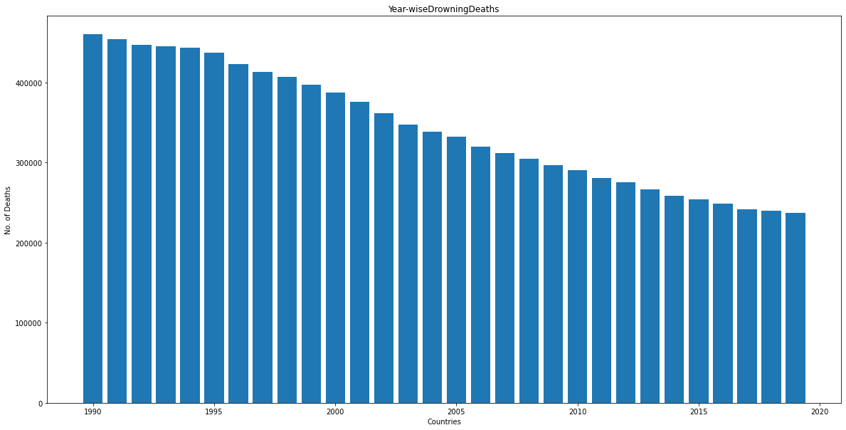
Death Counts over 30 years due to Drowning

Slide 46
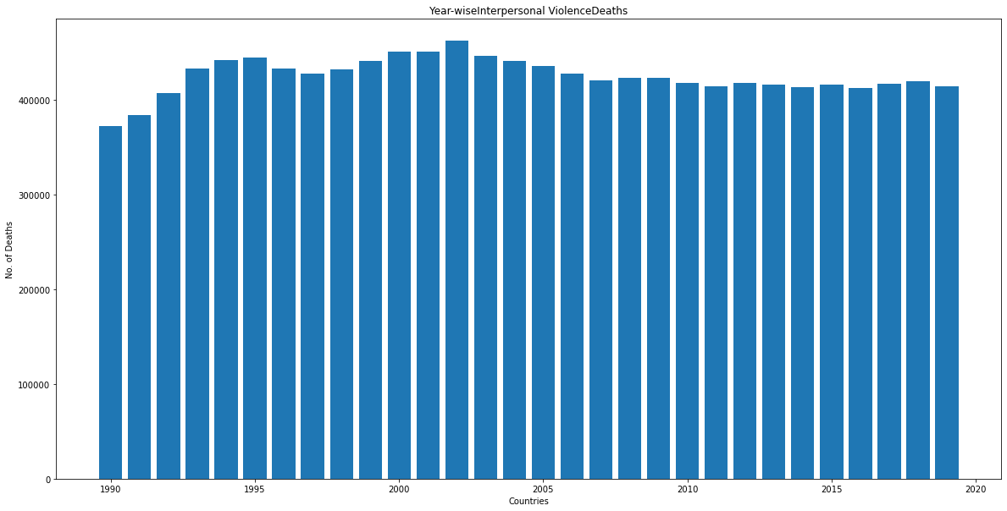
Death Counts over 30 years due to Interpersonal Violence

Slide 47
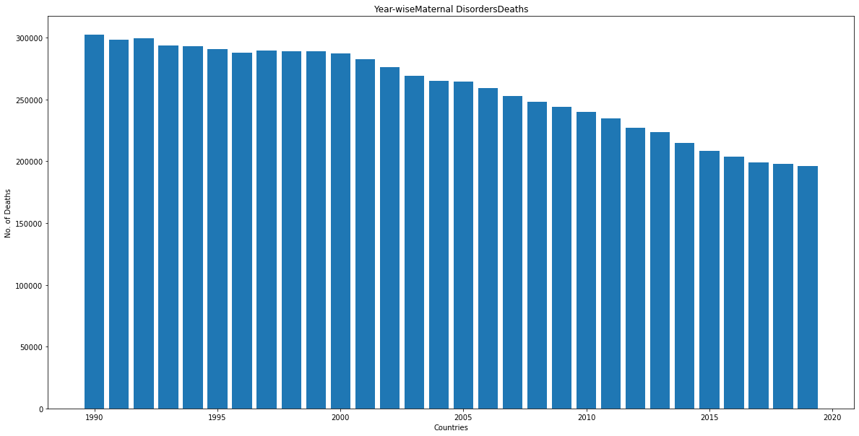
Death Counts over 30 years due to Maternal Disorders

Slide 48
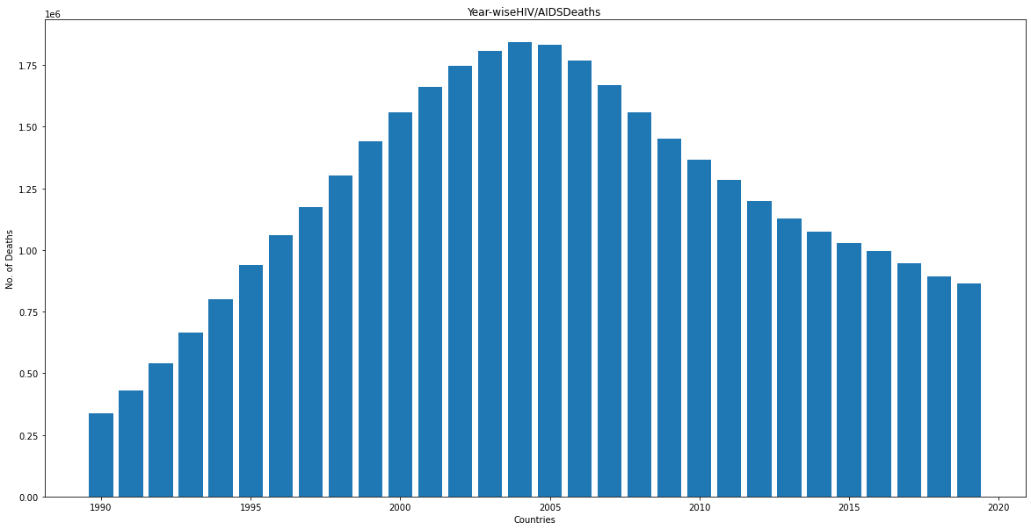
Death Counts over 30 years due to HIV/AIDS

Slide 49
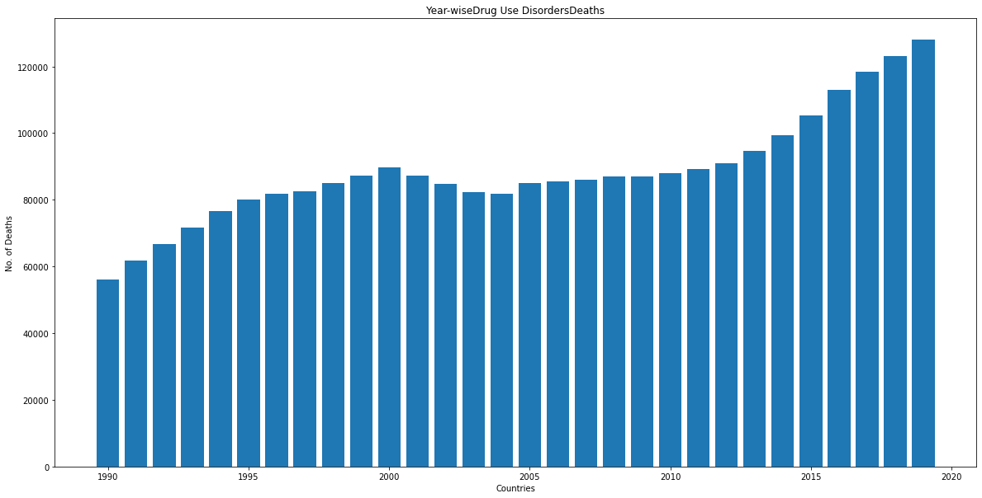
Death Counts over 30 years due to Drug Use Disorders

Slide 50
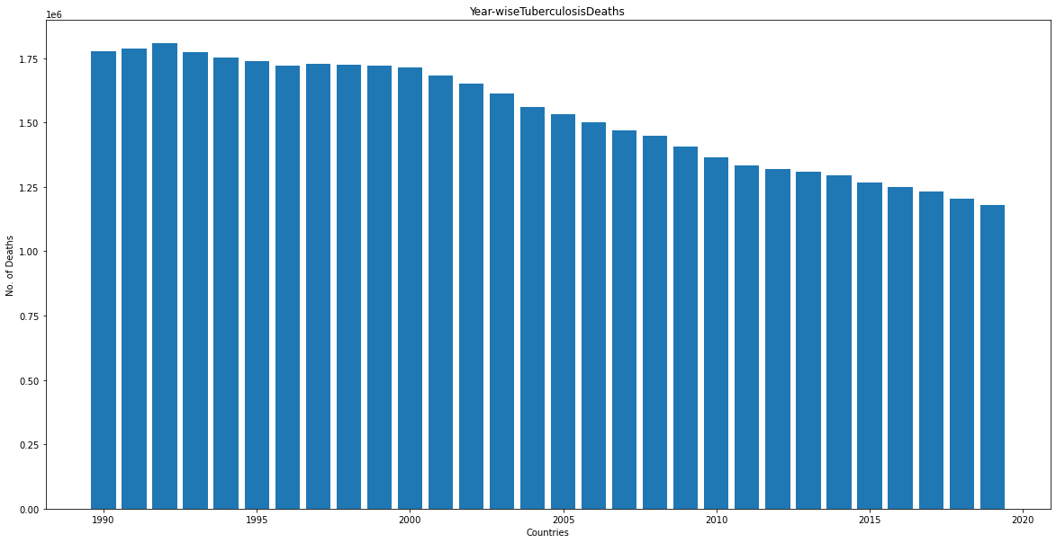
Death Counts over 30 years due to Tuberculosis

Slide 51
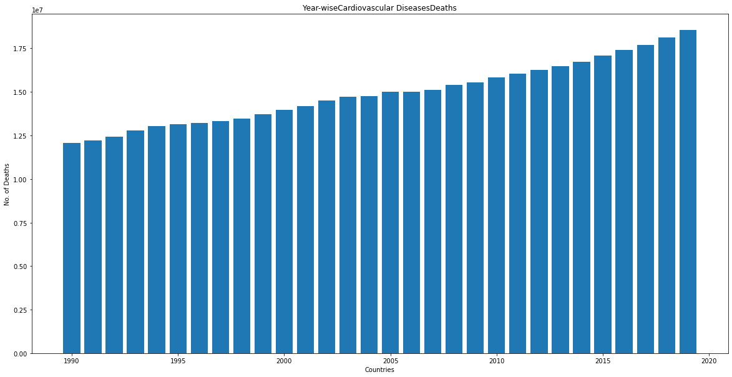
Death Counts over 30 years due to Cardiovascular Diseases

Slide 52
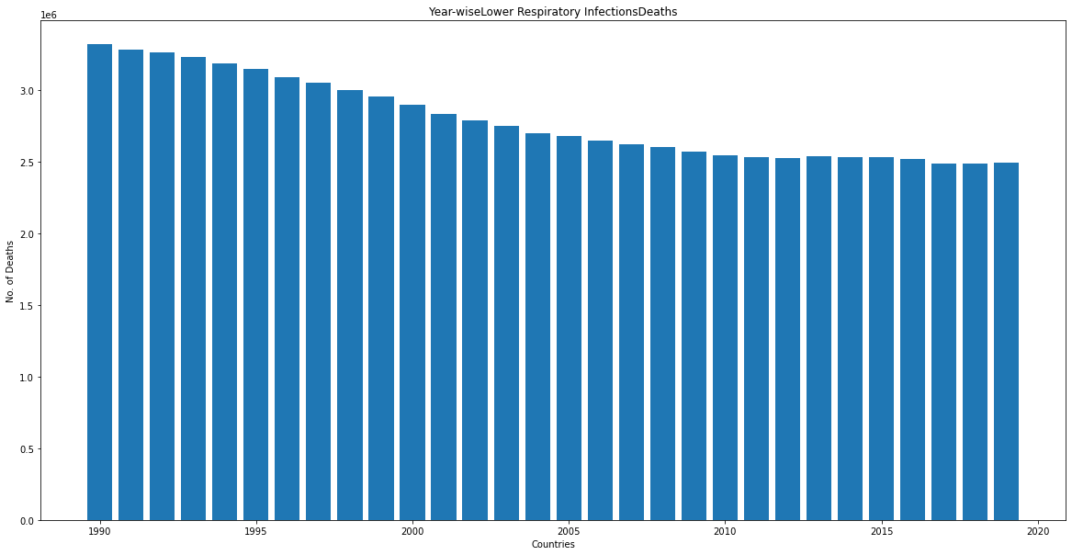
Death Counts over 30 years due to Lower Respiratory Infections

Slide 53
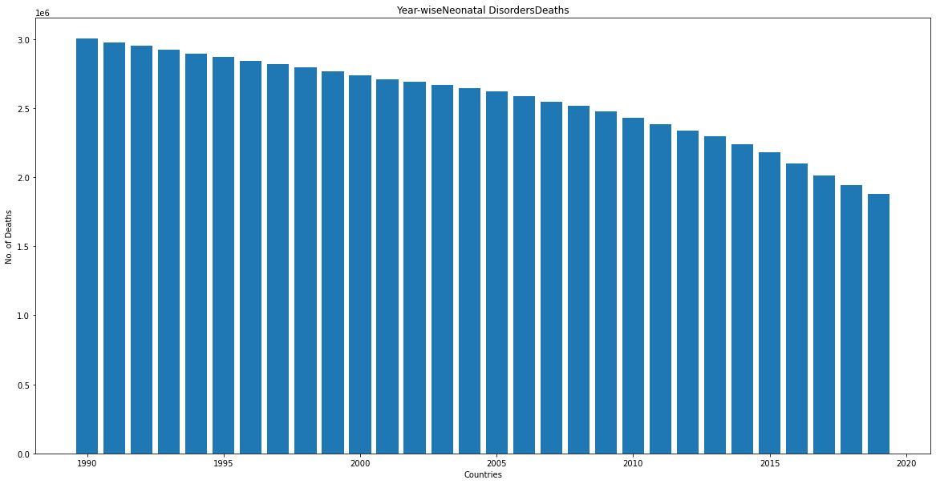
Death Counts over 30 years due to Neonatal Disorders

Slide 54
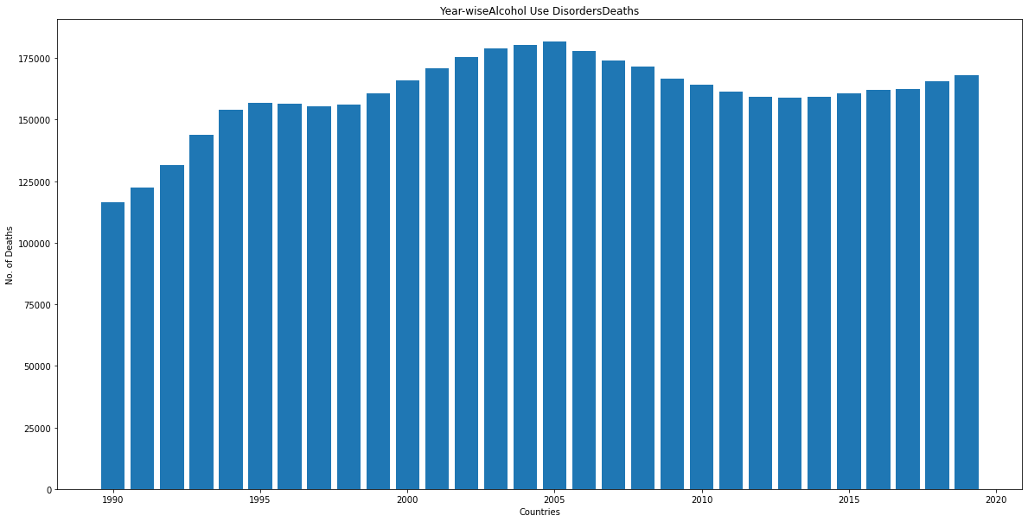
Death Counts over 30 years due to Alcohol Use Disorders

Slide 55
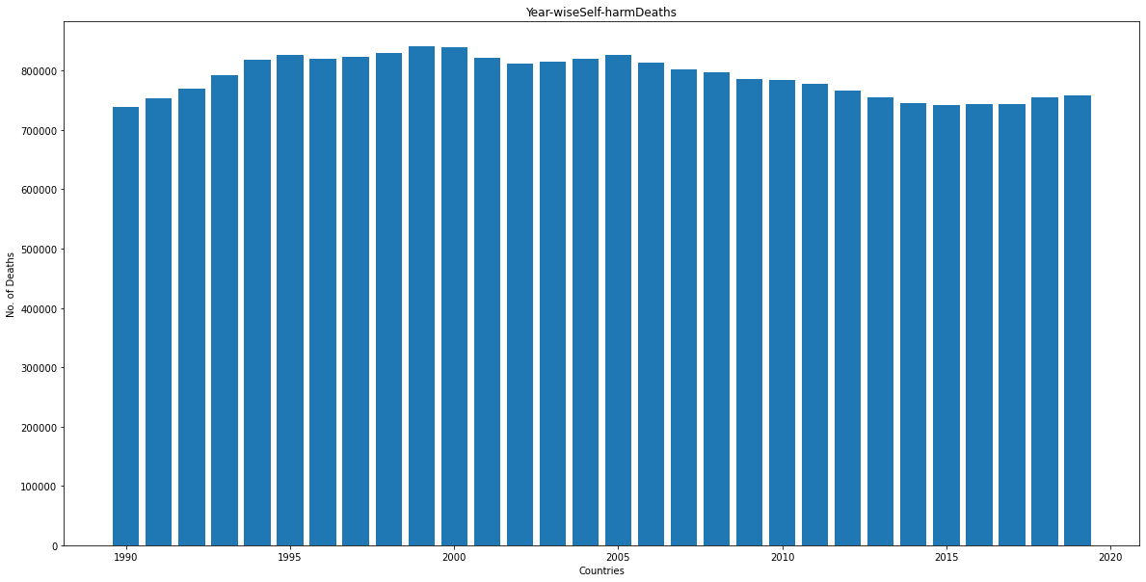
Death Counts over 30 years due to Self-harm

Slide 56
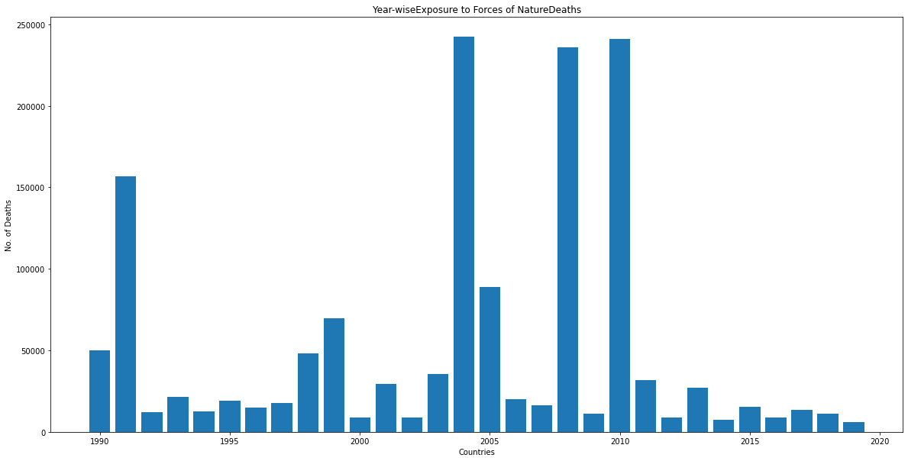
Death Counts over 30 years due to Exposure to Forces of Nature

Slide 57
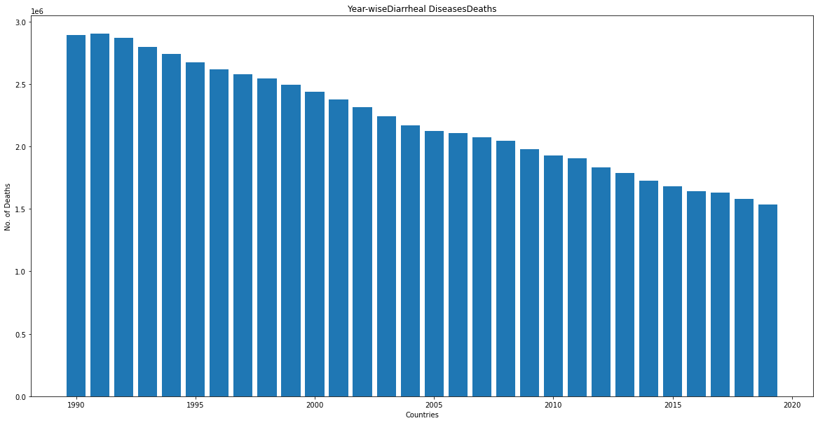
Death Counts over 30 years due to Diarrheal Diseases

Slide 58
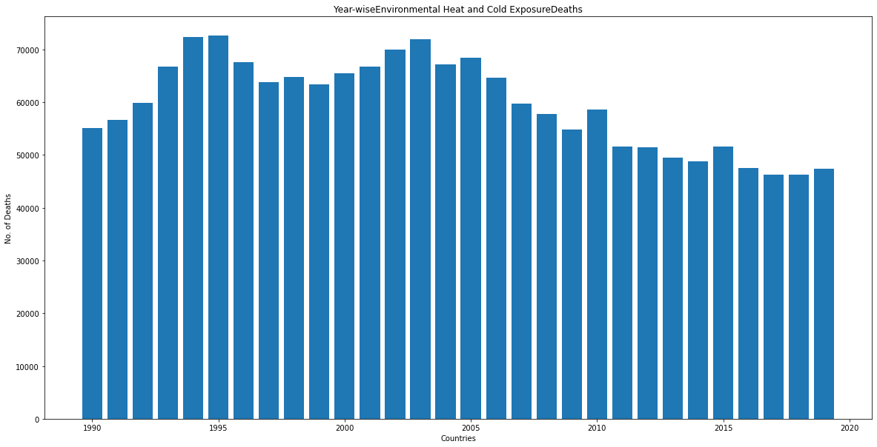
Death Counts over 30 years due to Environmental Heat and Cold Exposure

Slide 59

Death Counts over 30 years due to Neoplasms

Slide 60

Death Counts over 30 years due to Conflict and Terrorism

Slide 61

Death Counts over 30 years due to Diabetes Mellitus

Slide 62

Death Counts over 30 years due to Chronic Kidney Disease

Slide 63

Death Counts over 30 years due to Poisonings

Slide 64

Death Counts over 30 years due to Protein-Energy Malnutrition

Slide 65

Death Counts over 30 years due to Road Injuries

Slide 66

Death Counts over 30 years due to Chronic Respiratory Diseases

Slide 67

Death Counts over 30 years due to Cirrhosis and Other Chronic Liver Diseases

Slide 68

Death Counts over 30 years due to Digestive Diseases

Slide 69

Death Counts over 30 years due to Fire, Heat, and Hot Substances

Slide 70

Death Counts over 30 years due to Acute Hepatitis

Slide 71
Findings: Following diseases shows increasing death counts over 30 year (1990-2019)
Alzheimer's Disease and Other Dementias
Parkinson's Disease
Drug Use Disorders
Cardiovascular Diseases
Neoplasms
Diabetes Mellitus
Chronic Kidney Disease
Chronic Respiratory Diseases
Cirrhosis and Other Chronic Liver Diseases

Slide 72
Findings: Following diseases shows decreasing death counts over 30 year (1990-2019)
Meningitis
Nutritional Deficiencies
Malaria
Drowning
Maternal Disorders
Tuberculosis
Lower Respiratory Infections
Neonatal Disorders
Diarrheal Diseases
Poisonings
Protein-Energy Malnutrition
Acute Hepatitis

Slide 73
Findings: Following diseases shows almost same (with very little variation) death toll over 30 years
Interpersonal Violence
Alcohol Use Disorders
Self-harm
Fire, Heat, and Hot Substances
Road Injuries

Slide 74
Findings:
The no. of deaths due to HIV/AIDS were increasing up to 2003 then the downfall is observed till
2019
The no. of deaths due to Exposure to Forces of Nature (natural calamities like earthquakes,
volcanic eruptions, avalanches, storms, lightning strikes, and floods) are observed high in year
1991, 2004, 2008 and 2010
The trend of no. of deaths caused due to Environmental Heat and Cold Exposure (may be due to change in climate) is decreasing from 2005
In the year 1994 sudden surge of death count is observed more than 1 million later on, it came to know that t is because of genocide happened in Rwanda by searching on web.

Slide 75

Top 50 death toll Countries in the World

Slide 76

Top 50 death toll Countries in the World

Slide 77

Top 50 death toll Countries in the World

Slide 78

Top 50 death toll Countries in the World

Slide 79

Top 50 death toll Countries in the World

Slide 80
Findings:
China is ahead of all with more than 250 million of death count followed by India being second with more than 200 million.
USA is having death count 0.55 million being in third position, followed by Russia, Indonesia, Nigeria, Pakistan, Brazil, Japan, Germany.
It is seen that the death toll is proportional to the population.

Slide 81

% Death due to various causes in World

Slide 82

Death due to various causes in World

Slide 83
Findings:
Cardiovascular Diseases have more no. of deaths more than 400 million, 30.50% of total deaths
Neoplasms have deaths 234 million, 15.65% of total deaths
Chronic Respiratory Diseases about 110 million, 7.13% of total death
Lower Respiratory Infections 90 million, 5.71% of total deaths
Neonatal Disorder death toll is about 85 million, 5.24% of total deaths
Diarrheal and Digestive Diseases have 70 million death tolls, 4.51%, 4.47% of total deaths respectively.
Tuberculosis with 3.12% of total deaths with 35million death toll

Slide 84
Top 10 death toll countries with Top 10 death causes

Slide 85

Top 10 death causes in China

Slide 86

Top 10 death causes in India

Slide 87

Top 10 death causes in USA

Slide 88

Top 10 death causes in Russia

Slide 89

Top 10 death causes in Indonesia

Slide 90

Top 10 death causes in Nigeria

Slide 91

Top 10 death causes in Pakistan

Slide 92

Top 10 death causes in Brazil

Slide 93

Top 10 death causes in Japan

Slide 94

Top 10 death causes in Germany

Slide 95
Findings:
Cardiovascular Diseases are at top for death toll in all the top 10 countries
Diarrheal Diseases being the second one except China
Chronic Respiratory Diseases becomes the third and Neoplasms and neonatal becomes fourth

